Slide 1
Power BI Reinforcement project
Presented By:
  Sudheshna M
  DADS(July A)

Slide 2
DATASET Overview:
The Dataset [COVID-19] contains global country-level COVID-19 statistics, capturing confirmed cases, active cases, recoveries, deaths, and week-over-week changes. Each row represents a country, making it suitable for comparative analysis, KPI generation, and geographic visualization in Power BI.
Dataset Size
Total Rows: 180
Total Columns: 15
Data Quality Summary
No duplicate rows
No missing values
12 negative values found (replaced with 0)
All numeric fields valid
Country names clean and map-ready

Slide 3
Key metrics:
Total confirmed → 16M
Total deaths → 1M
Total Recovered → 9M
Total Active → 6M
Total New Cases → 229K
Total New Deaths → 5K
Total New Recovered → 175K

Slide 4
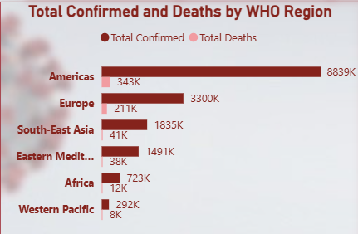
Total Confirmed & Deaths by WHO Region
Americas lead with the highest confirmed cases and deaths.
Europe follows with a large number of confirmed cases.
South-East Asia shows high confirmed cases, especially due to large populations.
Eastern Mediterranean has moderate but significant case numbers.
Africa reports comparatively lower totals but still notable.
Western Pacific shows the lowest levels among all regions.

Slide 5
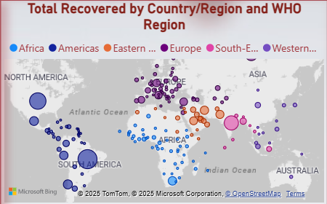
Geographic Map View
The world map highlights the distribution of active cases across countries.
Larger bubble sizes represent higher active case counts.
North & South America show dense, large clusters of active cases.
Europe has widespread distribution across multiple countries.
South-East Asia shows significant activity in heavily populated nations.
Africa shows moderate clustering with fewer extreme values.
Western Pacific includes Australia and East Asia with visible but varied case levels.

Slide 6
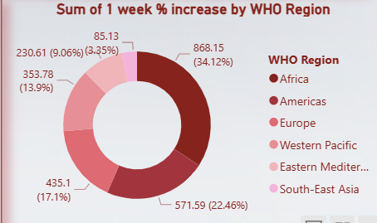
One-Week % Increase by WHO Region (Donut Chart)
Americas show the highest weekly increase, contributing over one-third of global growth.
Europe and Western Pacific also show steady percentage increases.
South-East Asia contributes around one-fifth of the week’s growth.
Africa and Eastern Mediterranean show moderate week-over-week growth rates.
These trends help in identifying regions.

Slide 7
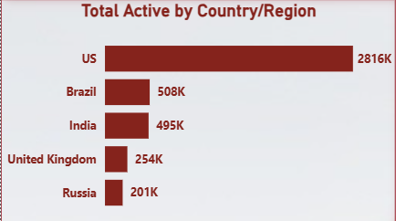
Total Active Cases by Country
• US has the highest active case count globally.
• Brazil and India follow closely with large active caseloads.
• United Kingdom and Russia also hold significant numbers.
• This ranking helps identify countries needing the most healthcare response.

Slide 8
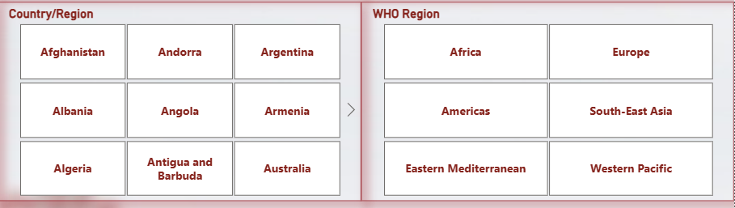
Country & WHO Region Filters
• Interactive slicers allow users to select a specific country or region.
• Filters update all visuals instantly for customized analysis.
• Useful for focusing on particular regions during presentations or reports.

Slide 9
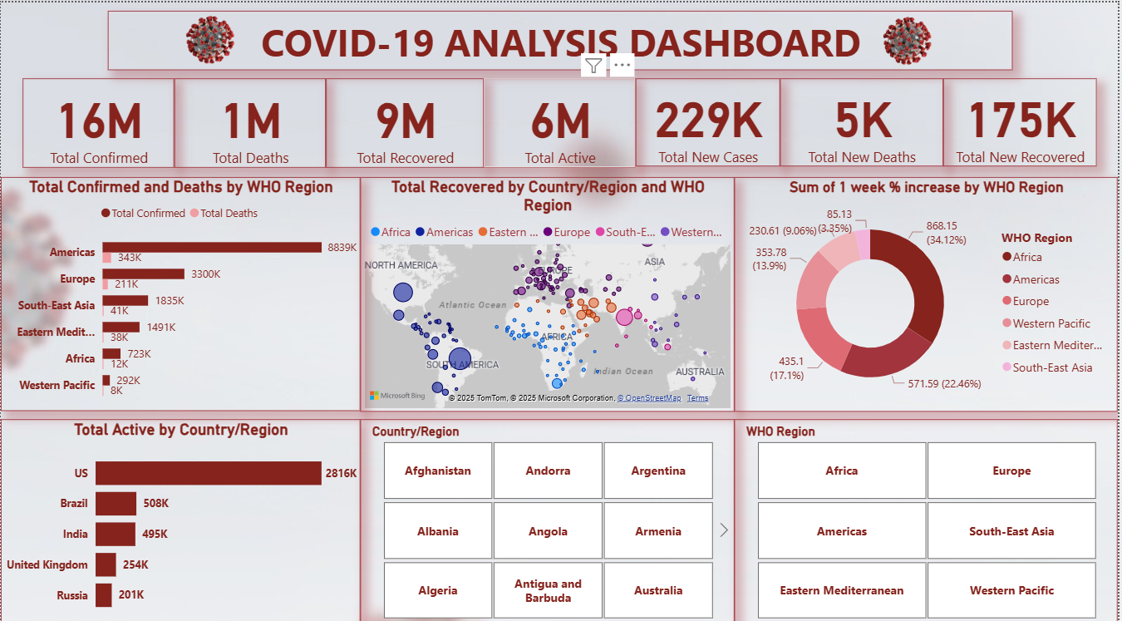

Slide 10
Insights
• Americas have the highest cases and deaths among all regions.
• Europe also shows high impact with strong case concentration.
• South-East Asia shows moderate to high activity with large population influence.
• The world map highlights major hotspots in North America, South America, Europe, and Asia.
• Weekly percentage increase is highest in the Americas, indicating fresh surges.
• Countries with highest active cases: US, Brazil, India, UK, Russia.

Slide 11
Thank you

